Slide 1
Storage and Indexes 2
Instructor: Kazi Amit Hasan

Slide 2
We have learned so far
Data storage
How data is being accessed from disk to MM for processing
Database files
Different types of organization of records in files

Slide 3
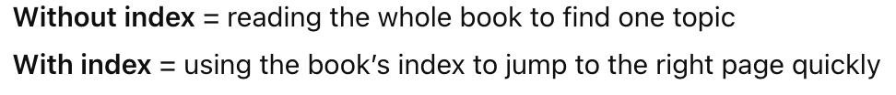

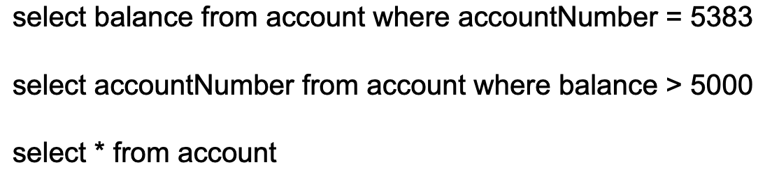
Accessing Data

Slide 4
Index Structures
Indexing mechanisms used to speed up access to desired data.
Eg: index in the back of a book
Topics are in sorted order
Page Number “points to” where we find more information
Significantly smaller than the book itself
But adds some bulk to the book

Slide 5
Index Structures
Database indices play the same role
Build an index on student ID
To retrieve a student record with ID = 1001
Look in the index to find the appropriate disk block that contains the data
Retrieve the block

Slide 6
How does an Index Help?
The index is in a different file than the data & contains less data.
Instead of scanning the full table, the DBMS first checks the index, finds where the needed rows are, and then reads only those specific data blocks.
Often one (or just a few) disk accesses required to get the entire index into main memory
Because the index is small, the DBMS can load most or all of it into RAM (main memory) quickly.

Slide 7
How does an Index Help?
A buffer pool (portion of main memory devoted to the DBMS) is often dedicated specifically for indices
The index is then used to quickly locate the blocks on disk that are needed
Only the blocks containing relevant data are then brought into memory
The index is structured so that we can search for things very quickly

Slide 8
Multiple Indices
Often have more than one index for a file
Index on salary to find all empl with salaries between x & y
And ... an index on employee id
And .. an index on department ....
Decisions on what indices to create depends on intended use of the database
Most DBMSs have automated tools that will suggest which indices to build based on workload analysis

Slide 9
Ordered Indices
Primary Index – an index built on the primary key
if employee_id is the primary key, then an index on employee_id is a primary index
Clustered Index:
the index is sorted on the search key and this determines the ordering of the tuples in the sequential data file
(the index and data are sorted on the same attribute)
Secondary index: an index whose search key specifies an order different from the sequential order of the file. Also called non-clustering index.

Slide 10
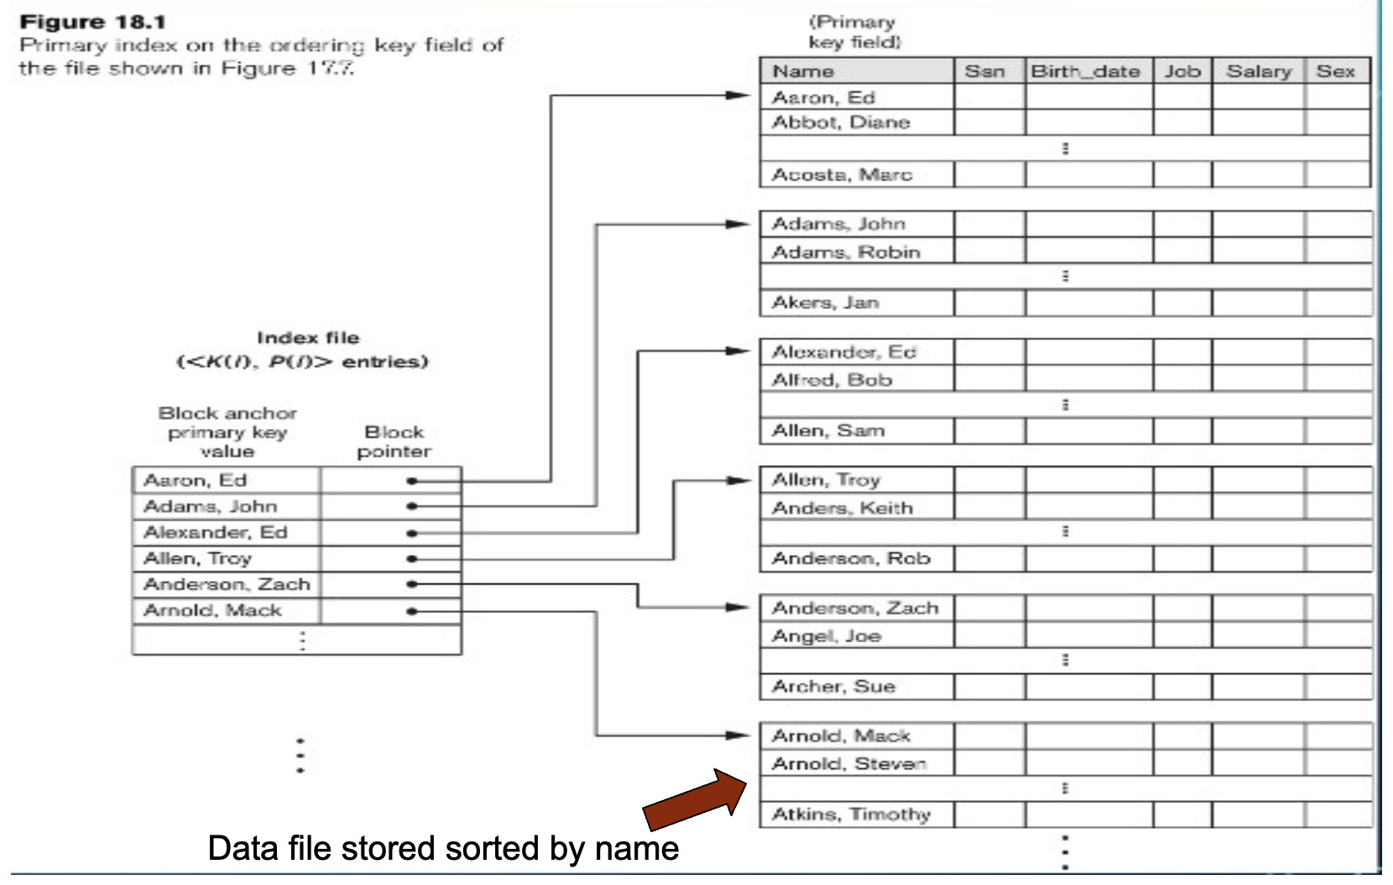
Clustered Index (sparse)
index entries (and data) are stored sorted on the search key

Slide 11
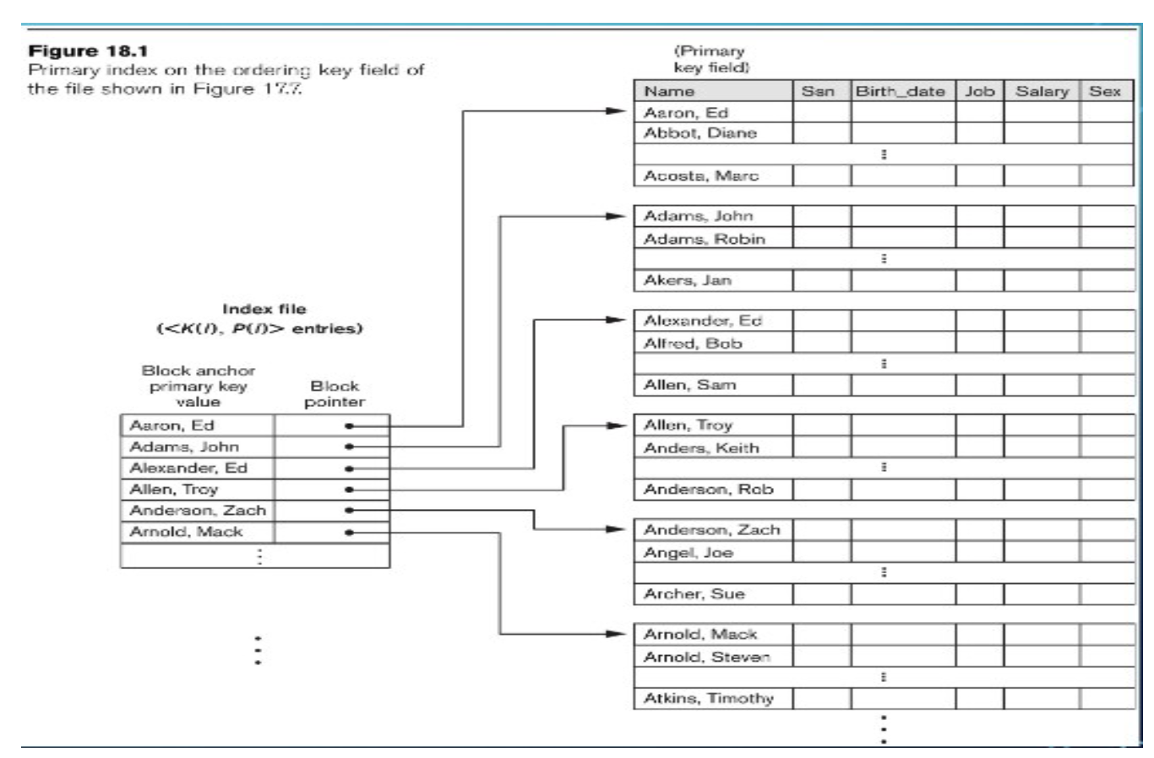
Sparse Index
An index entry for only the first record of each block.

Slide 12
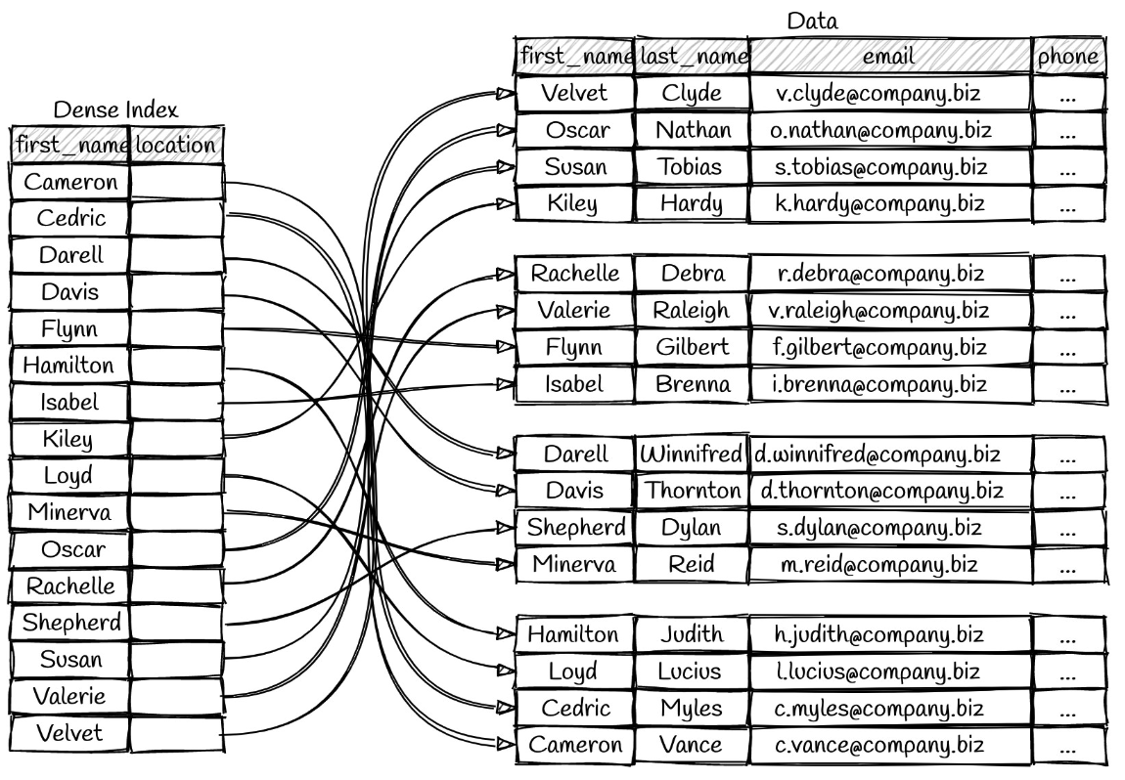
Dense Index Files
Dense index — Index record appears for every search-key value in the file
Index is sorted for quick access but file may be sorted differently
This is an unclustered index

Slide 13
Comments
Indices offer substantial benefits when searching for records.
BUT: indices impose overhead on database modification
when a record is inserted or deleted, every index on the relation must be updated
When a record is updated, any index on an updated attribute must be updated

Slide 14
Multilevel Index
An index is supposed to help us search fast.
That works best when the index can stay in main memory (RAM).
But if the index itself becomes very large, then the DBMS must also read parts of the index from disk.
That makes lookup slower again.
Solution? >> Multilevel index

Slide 15
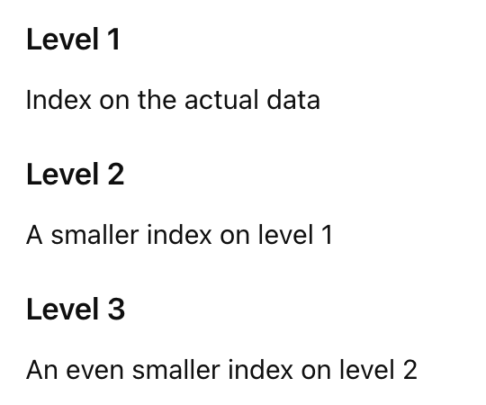
Multilevel Index
Index of index
treat index kept on disk as a sequential file and construct a sparse index on it.
instead of searching one huge index, you search in layers.

Slide 16
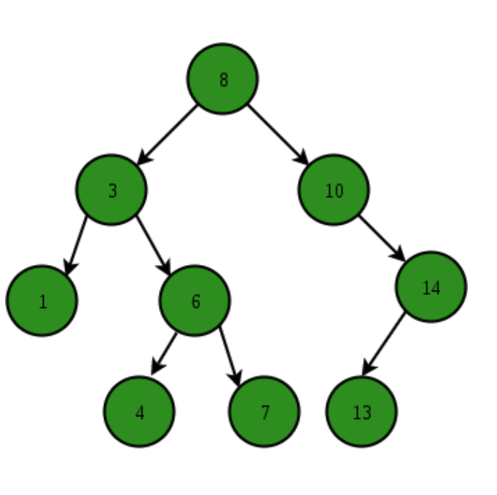
Example: B+-Tree Index Files
Index is built using a B+ tree structure
fast inserts, deletes and lookups if tree is kept balanced!
index size is relatively small

Slide 17
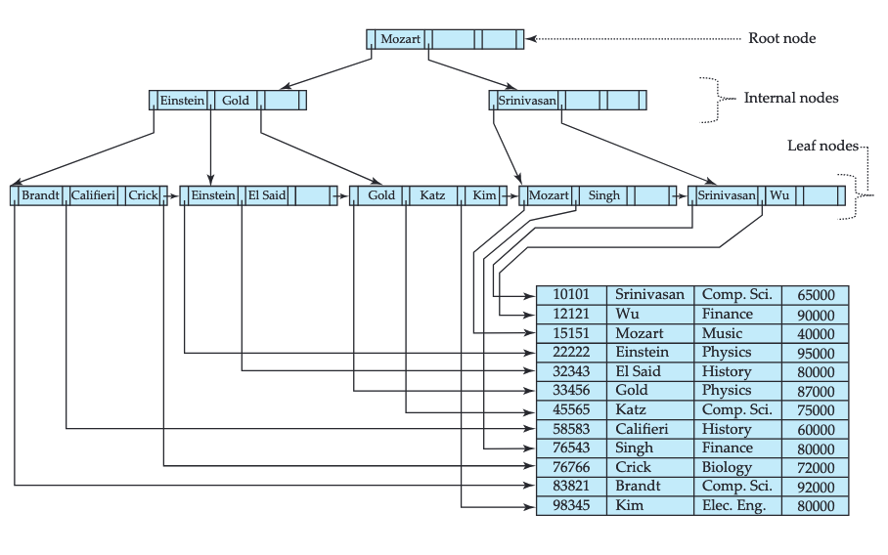

Slide 18
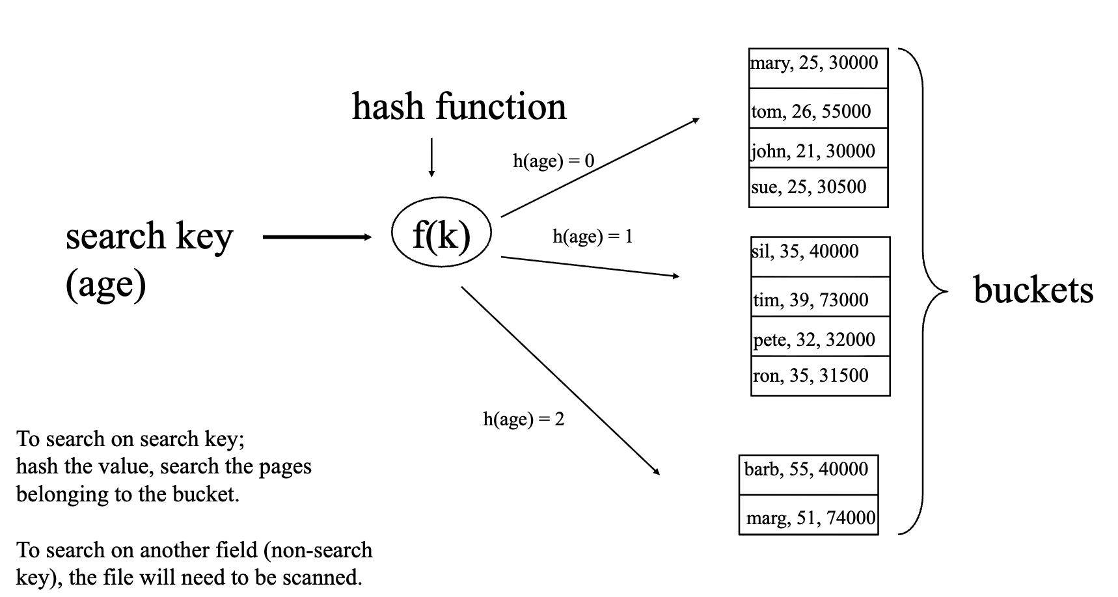
Hash Index Concept

Slide 19
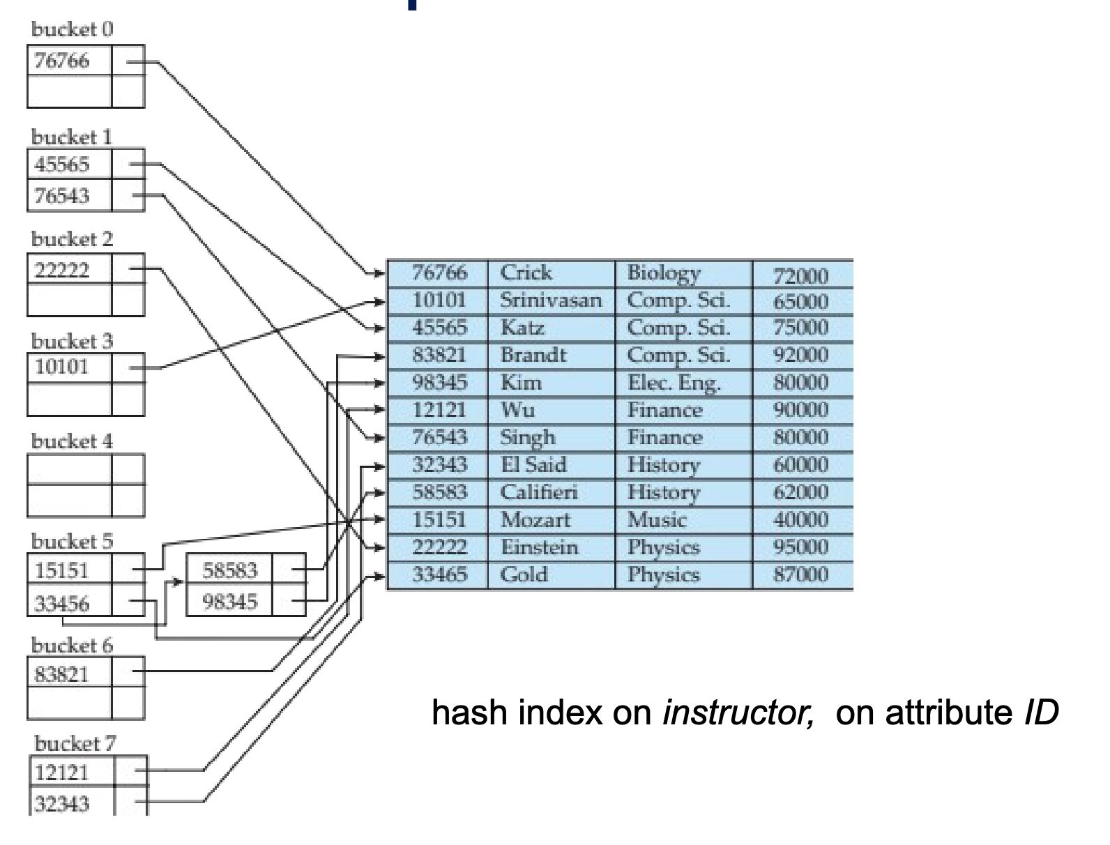
Example of Hash Index

